Slide 1

Major Project Presentation
Computer Vision and Deep Learning for Early Disease Diagnosis and Prediction
Presented by:
SANDIPAN DUTTA : 27630822001
REHAN HEJAZI : 27630822008
BASUDEV DAS : 27630822018
RISHI RAJ : 27630822023
DHRITI SUNDAR MANIK : 27630822027
Supervisor: Prof. Subhadeep Majumdar
Department of Computer Science Engineering (Artificial Intelligence)
BUDGE BUDGE INSTITUTE OF TECHNOLOGY
July 13, 2026

Slide 2
OBJECTIVE
The main objective of our project is to develop an intelligent system capable of detecting pneumonia from chest X-ray images using Computer Vision and Deep Learning.
To build a CNN-based model for early diagnosis of pneumonia.
To utilize Kaggle chest X-ray datasets for training, validation, and testing.
To design a user-friendly web interface to display prediction results with probability percentages.
To support early disease detection, assisting healthcare professionals in faster screening.

Slide 3
ABSTRACT
This project presents PneumoScan-AI, an intelligent diagnostic system using computer vision and deep learning to detect pneumonia from chest X-ray images.
The baseline CNN was upgraded to a DenseNet121 architecture using transfer learning, fine-tuned on ~20,000 chest X-ray images from two Kaggle sources.
Model achieves 86.67% training accuracy, AUC of 0.9561, recall of 89.38% — with early stopping halting training at epoch 5.
The Streamlit web app is now publicly deployed on Hugging Face Spaces — users can upload X-rays and get predictions instantly via browser.

Slide 4
LITERATURE REVIEW
CheXNet: A deep learning model developed by Stanford University using DenseNet121, achieving radiologist-level performance in pneumonia detection from chest X-rays.
DenseNet121: A powerful convolutional neural network architecture that improves feature reuse through dense connections, enabling better gradient flow and improved performance in medical image classification tasks.
Kaggle Chest X-ray Dataset: A publicly available dataset widely used as a benchmark for pneumonia detection research and deep learning model evaluation.

Slide 5
USED TECH STACK
Language: Python 3.x
Core Libraries:
TensorFlow & Keras: For building and training the CNN model.
OpenCV: For image loading, resizing, and preprocessing.
NumPy: For numerical operations and data handling.
Matplotlib: For result visualization and plotting training performance.
Streamlit: For creating the interactive web interface for predictions.
Development Environment: Visual Studio Code (VS Code)

Slide 6
PROPOSED APPROACH
The proposed approach for our system focuses on detecting pneumonia from X-ray images using a deep learning CNN model integrated with a Streamlit-based web app.
Data preprocessing: Cleaning, resizing, and augmenting X-ray images.
Model training: Building and training CNN using TensorFlow/Keras.
Testing & validation: Evaluating accuracy and minimizing loss.
Deployment: Integrating the trained model into Streamlit for real-time predictions.
Web interface: Allowing users to upload X-rays and instantly view pneumonia probability results.

Slide 7
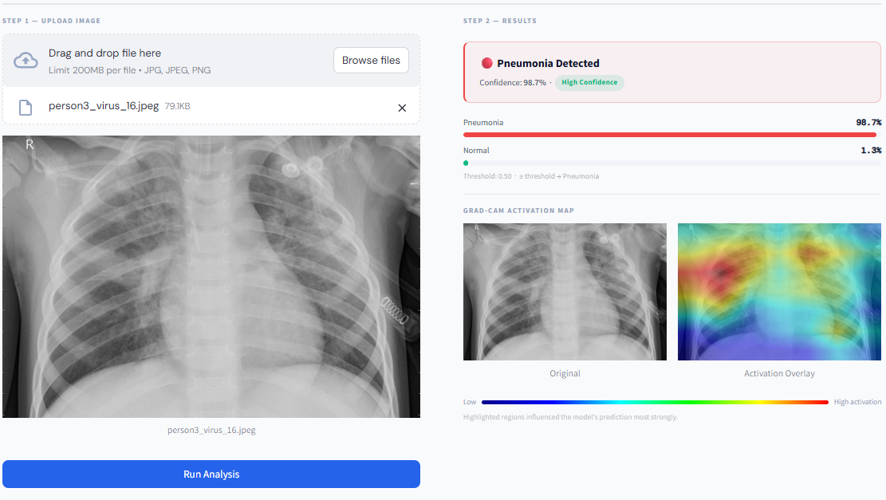
OVERVIEW OF USER INTERFACE
Developing using Streamlit, providing a clean and responsive web layout.
Upload Section: Users can upload chest X-ray images in JPG/PNG format.
Prediction Output: Displays pneumonia probability and confidence scores.
Visualization: Shows side-by-side image and model result.
Interactive Experience: Real-time results without reloading the page.

Slide 8
OVERVIEW OF BACKEND SURFACE
Model Integration: Trained CNN model is loaded in Python using TensorFlow.
Streamlit Backend: Handles user uploads, passes images to model, and displays results dynamically.
Processing Pipeline: → Image upload → Preprocessing → Model prediction → Display on Streamlit UI
Advantages: Lightweight deployment, fast inference, easy to run locally or host online.

Slide 9
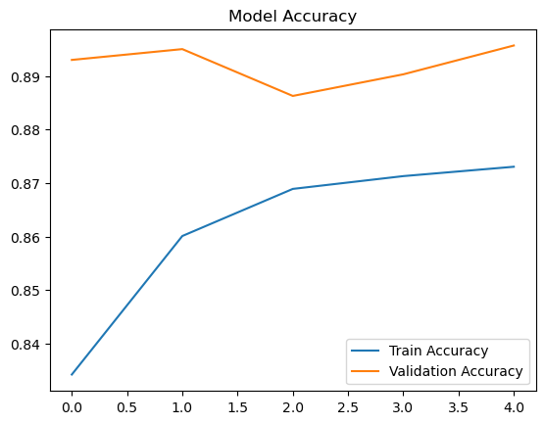
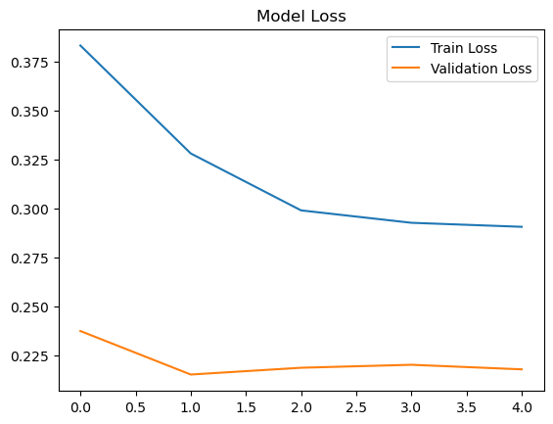
MODEL TRAINING SNAPSHOT
Model Training & Performance
Training Accuracy: 86.67% Validation Accuracy: ~88% | AUC: 0.9561 | Precision: 82.73% | Recall: 89.38%
Epochs: 5/20 (Early Stopping halted at epoch 5, best weights restored)
Model Architecture: DenseNet121 (Transfer Learning)
Framework: TensorFlow / Keras
Visualization: Matplotlib (for training accuracy and loss graphs)
Interface Tool: Streamlit (for interactive prediction and testing)

Slide 10
Current Progress
Phase 1 (Done): Merged two Kaggle chest X-ray datasets into a combined ~20,000-image dataset; applied preprocessing and augmentation.
Phase 2 (Done): Replaced baseline CNN with DenseNet121 transfer learning model; trained with early-stopping (stopped at epoch 5).
Phase 3 (Done): Built Streamlit frontend integrated with trained model for real-time X-ray upload and pneumonia prediction.
Phase 4 (Done): Deployed app publicly on Hugging Face Spaces — accessible at basudevdas-pneumoscan-ai.hf.space
All 4 phases complete — system is live and fully functional.

Slide 11
CONCLUSION
PneumoScan-AI successfully demonstrates an end-to-end AI-assisted pneumonia screening pipeline. By upgrading from a basic CNN to DenseNet121 transfer learning on ~20,000 chest X-rays, the system achieves 86.67% training accuracy, an AUC of 0.9561, and a recall of 89.38% — making it reliable for flagging pneumonia cases. The Streamlit web app is now live on Hugging Face Spaces, meaning any user can test the model from a browser without any local setup. This project shows how practical and accessible AI diagnostic tools can be built and deployed with open-source tools.

